Slide 1
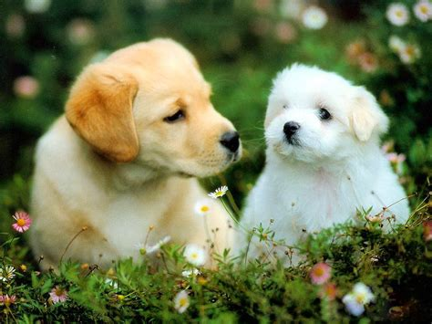
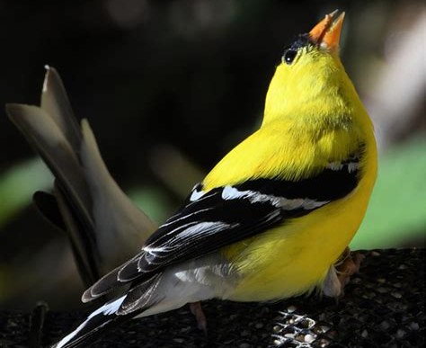
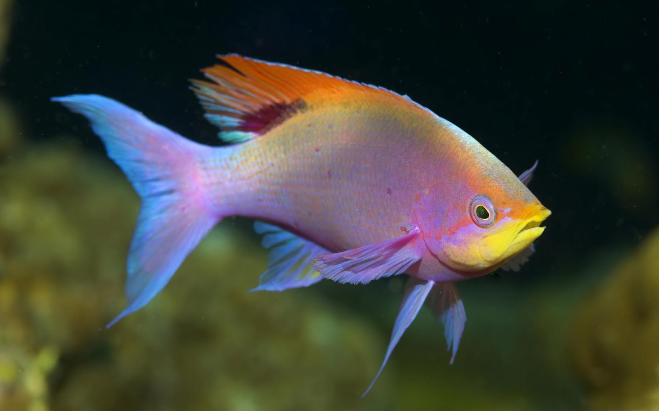
Classifications – Page 1
In the following passage, underline or highlight all the key-words and information. Then, answer the questions on the back
Classification of animals is a fundamental aspect of understanding the natural world. It allows us to organise and make sense of the wide variety of animal species on our planet. By grouping animals based on certain characteristics, we can learn more about their similarities, differences, and relationships. In this worksheet, we'll look at the importance of classifying animals and examine two examples: dogs and birds.
Dogs belong to the group known as mammals. Mammals are defined by several key characteristics, including giving live birth, having body hair or fur, and feeding their young with milk. By classifying dogs as mammals, we understand they share these common features with other mammals, such as cats, kangaroos, and dolphins. This classification also tells us about certain behaviours we can expect from dogs, like nurturing their young and maintaining a certain body temperature.
Birds, on the other hand, belong to a different classification. Birds are known for their ability to fly, laying eggs, and having feathers. By grouping birds together, we recognise they share these traits and behaviours. Birds include a wide variety of species, such as sparrows, eagles, and ducks. Despite their differences, these species all share core characteristics that classify them as birds.
Fish, our third example, occupy yet another distinct classification. They live in water, breathe through gills, and most lay eggs. Fish, which include species ranging from tiny guppies to large sharks, have scales covering their bodies. This common feature, along with others, helps us understand the aquatic lifestyle of fish and their unique adaptations to life in water.
Understanding the classification of animals is crucial as it reveals important information about an animal's physiology, behaviours, and lifestyle. It also shows us how diverse life on Earth is, helping us appreciate the myriad forms of life that inhabit our world.

Slide 2
Classifications – Page 2
What does classifying animals help us understand?
______________________________________________________________________
What group do dogs belong to, and what are some key characteristics of this group?
______________________________________________________________________
______________________________________________________________________
What are some behaviours we expect to see in dogs?
______________________________________________________________________
What group do birds belong to, and what are some key characteristics of this group?
______________________________________________________________________
______________________________________________________________________
What are some behaviours we expect to see in birds?
______________________________________________________________________
What group do fish belong to, and what are some key characteristics of this group?
______________________________________________________________________
______________________________________________________________________
What are some behaviours we expect to see in fish?
______________________________________________________________________
Why is the classification of animals important?
______________________________________________________________________
______________________________________________________________________

